Slide 1
The Norwegian «Institutional profile project»
How to measure institutional profiles in the Norwegian HE landscape
Ole-Jacob Skodvin, Deputy Director General, Department of analysis and Development, Norwegian Agency for Quality Assurance in Education

Slide 2
Diversified higher education systems?
All countries have an intention or a political goal of having a diverse higher education system
  Institutions with different profiles, end products etc.
  In principle, a clear division of labor and specialization among the different types of institution - in sum, they provide what society needs in education, research, dissemination and innovation
Notes:
From a political point of view, diversity has been seen as something good and valuable, and most governments have identified a diverse higher education system as a policy goal

Slide 3
What do we mean by institutional diversity? A classification on forms of differentiation and diversity
Forms | Object of study
External diversity (system level) | Classification, typology, comparison of institutions
Internal diversity and differentiation (program level) | Classification, typology, comparison of disciplines/programmes
Differentiation of roles and functions | Differentiation (development, change) of functions, roles and structures
Notes:
In organizational studies of higher education (Huisman 1998), it is usual to distinguish between three different forms of institutional diversity and differentiation:

Slide 4
Why is diversity perceived as positive?
Diversity is seen as positive because it is expected:
  To increase students’ options (meet students needs and leading to increased social mobility)
  increases the overall efficiency of the higher education system:
    It opens up higher education for the community
    It facilitates and maintains specialization within the system
    It meets the demands of an increasingly complex society and labor marked

Slide 5
Why is diversity perceived as positive?
Provides opportunity to use different organizational models
Protects institutional autonomy
Allows both an elite education and a mass education
Provides for division of labor and specialization in relation to research and development
Paves the way for reforms through institutional competition

Slide 6
What controls diversity?
State control versus market
Public authorities' management of higher education: Using the metaphor "Gardener”
Care for and maintain diversity - (and weed out unwanted “weeds”)
Notes:
When it comes to what is driving diversity, it is generally known as two different control mechanisms set up against each other: state control versus the market.
The authorities are using instruments such as financial regulation and stimulation to achieve the differences between sectors of the system.
In systems where the government has less influence on higher education, market competition encourage institutions to find their own niche.

Slide 7
Different higher educational models
A diversified and multipurpose system
  USA and Canada
A binary system (A University sector and a specialized college sector –vocationally oriented
  Germany, Austria, Switzerland, the Netherlands and Finland
A unified system
  UK and Australia:All institutions have the university name, however – they are in different "divisions" - clear status differences between the institutions
A transparent binary system with opportunities for " advancement “ (but not “degradation”/”relegation”)
  Norway and Sweden
Notes:
Australia and UK abolished their binary systems in 1988 and 1992 respectively, and replaced it by a unitary one.
Degradation is theoretically possible – but it has not happened yet.

Slide 8
The contours of a new education landscape?
Higher education is characterized by increased competition for students nationally and internationally
Research is changing in the direction of larger academic communities - where the intention is higher quality
The interdisciplinary and multidisciplinary approach increases
The international competition for research funding and talent increases
Several countries are establishing elite universities
Notes:
This competition promotes quality, but can also create unintended barriers to the national cooperation and good use of resources across institutions.

Slide 9
Higher education in change in the Nordic countries
Higher Education is linked to economy – the value creation perspective
Global competition for talent
Consequence: The HEIs seek to concentrate their academic, economic/-administrative resources into larger and more competitive units
Cultivates the formation of elite institutions
  USA and UK have had such institutions for a long time – several countries are now following this trend
  The German excellence initiative with selected «lighthouses»
  France – the authorities have signaled a major effort to build up new elite institutions
Notes:
It appears that the structural changes in the other Nordic countries follow the general dynamics in the OECD area.
OECD do to a large degree relate higher education to economy.
At the same time there is increasing international competition for talent - that is, the best students and researchers - and the competition becomes increasingly global.
One consequence is that the higher education institutions are seeking to concentrate the academic, economic and administrative resources into larger, more competitive and powerful units.
Several countries have begun to focus on the creation of elite universities. U.S. and UK have had elite institutions for some time - and now several European countries follow after (including Germany and France).

Slide 10
Norway
In the international context – the Norwegian University College sector is unique:
  No other country spends so much time and resources on R&D in their vocationally oriented higher education sector
There is a huge drift in the University College sector to reach university status
  The Norwegian HEIs are regulated by the same law, have a common job position structure, a joint reward and career system and common academic norms and values
Are we going in the direction of getting pale copies of the original?
  Should all institutions be allowed to call themselves universities?
  The point is not what they're called - but what they actually do - or ….?
Notes:
Will the new universities be pale copies of the originals?
Alternatively, you can choose to maintain diversity by using incentives that stimulate various forms of institutional profiles that together will provide what the society needs in terms of education, research, dissemination and innovation
The slogan should be: «Different but equal»

Slide 11
Norway (II)
Outline of a new HE landscape in Norway
  Several voluntary cooperation alliances and mergers
  HEIs want to enhance their position in the regional, national and/or international HE market
  The Ministry supports cooperation, specialization, concentration and division of labor
  Rhetorical level: Stimulate quality along different axes in a diversified HE-system
Notes:
Today we can see the outline of a new HE landscape in Norway
Several voluntary cooperation alliances, consortia and mergers
HEIs want to enhance their position in the regional, national and/or international HE market
The Ministry of Education and Research supports the increased focus on cooperation, specialization, concentration and division of labour among the HEIs
Rhetorical level: Stimulate quality along different axes in a diversified HE-system

Slide 12
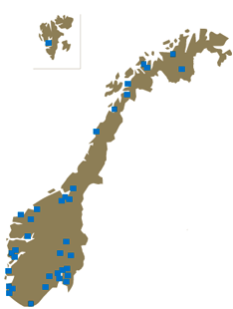
The Norwegian HE system
Notes:
The Norwegian HE-institutions are dispersed throughout the country – and there are great differences between the various HEIs concerning size, academic profile and organizational structure, as well as geographic location
The HE-sector in Norway now encompasses: 8 universities; 8 specialized university institutions, of which 3 private; 2 academies of the arts; 23 state university colleges; and 32 private university colleges) .
In addition we have The Police academy and 4 defense academies.
In total – we have approximately 230 000 students and 30 000 staff (2009).

Slide 13
How to measure diversity?
As part of Result oriented Planning - the Ministry of Education and Research annually conducts an individual consultative steering dialogue meeting with each public HEI
  Can be seen as an instrument to secure a diversified HE-sector in Norway
  Measure diversity by different performance indicators – but in addition try to classify the HEIs institutional profiles
  Developed a tool to describe the diversity in the Norwegian HE-sector – “The flower project”

Slide 14
Classification of higher education institutions – Institutional profiles
Based on the EU classification project - U-Map
Important in order to:
  Visualize the HEIs' profiles and unique purposes
  Support quality cultures along different axes
  Strengthen the HEIs’ capabilities to formulate clear objectives and strategies
  To show the HEIs’ profiles and purposes to the outside world
  Facilitate comparison between similar HEIs (difficult with the current ranking system)
  Can be developed to be a useful input in the Ministry's management and steering of the higher education sector
Notes:
Viewed from the Ministry's perspective, the European Classification project is both exciting and relevant. It is important to have a project that focuses on diversity as well as uniqueness among the HEIs.
With regard to the latter point line - it is clear that such a classification model can be a useful tool in the Ministry’s management and steering of the HEIs.

Slide 15
Classification of higher education institutions – Institutional profiles
Norway is in a unique position though the national database for statistics on higher education (DBH)
Statistical information on the institutional level is reported from all the HEIs to DBH
  All the dimensions – and most of the indicators in the U-Map project, are covered in our national public statistics
This gives the Ministry a possibility to develop a somewhat simplified and modified version of the U-Map project – based on statistical register data
Notes:
Norway is in a unique position though the national database for statistics on higher education (DBH)
Statistical information on the institutional level is reported from all the HEIs to DBH, and with some preparation, it provides almost all the indicators that are required in the classification system (U-Map)
All the dimensions – and most of the indicators in the U-Map project, are covered in our national public statistics
This gives the Ministry a possibility to develop a somewhat simplified and modified version of the U-Map project – based on statistical register data
The Ministry then started a development work on institutional profiles in the Norwegian public HEI-sector

Slide 16
Classification of higher education institutions – Institutional profiles
These are indicators that are part of the national funding system, performance indicators that are reported to the Ministry, and other quality assured indicators
The project has been named "Flower" - and shows roughly the institutional profiles we have in the Norwegian higher education system
Check out DBH’s website:
  http://dbh.nsd.uib.no

Slide 17
An overview of dimensions and indicators in the
”Flower”
Size | Education | Research
Size of institution (measured in number of students) | Vocationally oriented profile Master students Continuing and further education students Student credit points production The students’ age profile Part-time students Student popularity (number of qualified applicants) | Academic staff profile (share of associate professors and professors) Doctoral degree production) Academic publication (extent of publication points) Research funds from EU and NRC (Norwegian Research Council)
Economics and Resource Management | Internationalization | Relations with society
Implementation of the budget (Write-off) Allowance (Provisions as a percentage of revenue) Commission contract work Liquidity | Exchange students (per registered students in total) | Contributions to activities outside the EU and NCR Contract work (as percentage of total expenditure) Business ideas
Notes:
In our classification system, it will be operated with 6 dimensions and a total of 20 indicators. The six dimensions and their indicators are presented in the table.
The project has been named "Flower" - and shows roughly the institutional profiles we have in the Norwegian higher education system

Slide 18
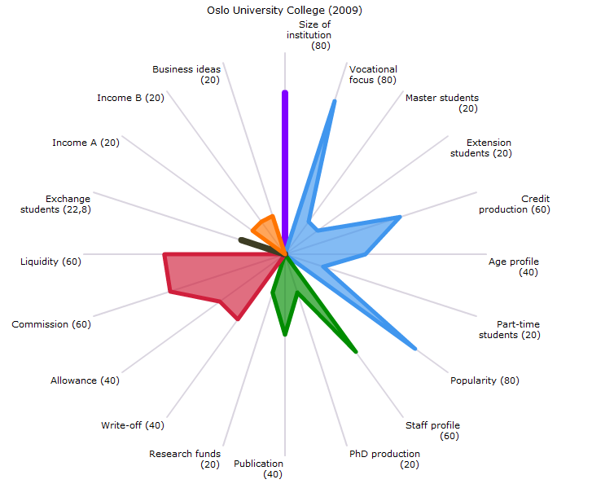
Notes:
The visualization of institutional profiles can be said to be the petals of a flower. Each petal represents a dimension or indicator area with its unique color. Each indicator area /dimension has its indicators.
In our flowers – the "Education-field" has a blue color, "Research" is green, “Economics and Resource Management" is red, "Relations with society" is orange, "Institutional Size" is purple and the "internationalization" is brown. The scale used runs from 0 to 100
It must not be interpreted to mean that something is bad or good. If for example a HEI has a clear vocational oriented profile, many students taking continuing and further education, a mature student population, etc., then it's just a simple description of what kind of institution this is. The universities have a different institutional profile than the state colleges – that also is the intention (larger share of master degree students, more doctoral production, publishing, etc.) - they actually have different purposes.
Some of our institutions has a specific regional role, others have both a regional and a national role, and others are again responsible for the full spectrum from the regional, national and to the global arena.

Slide 19
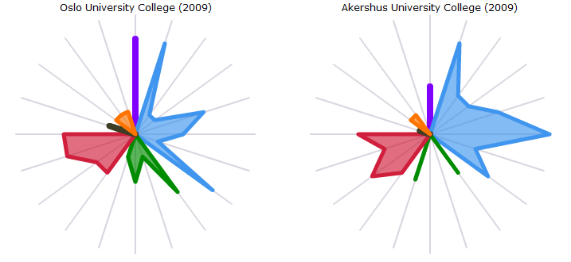
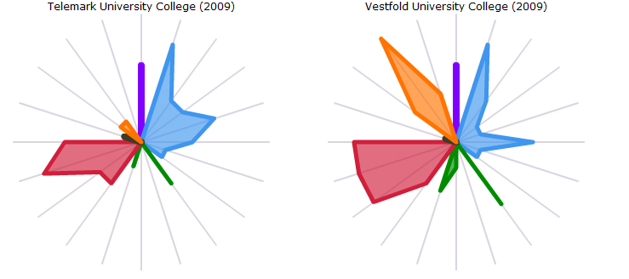

Slide 20
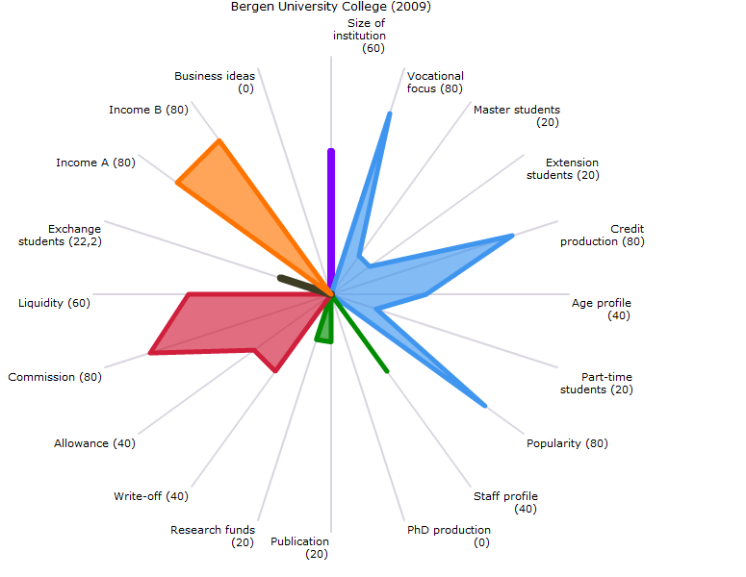

Slide 22
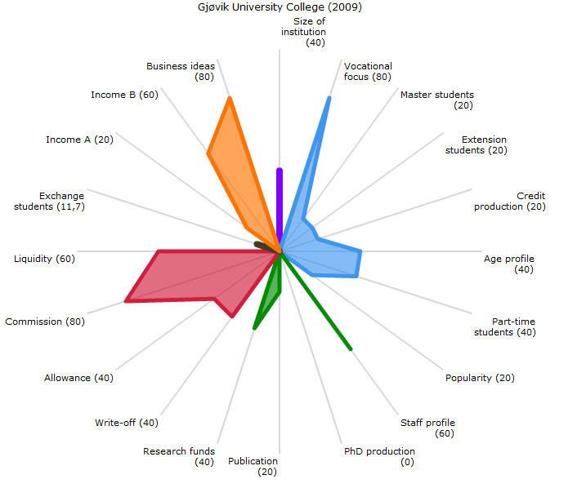

Slide 24
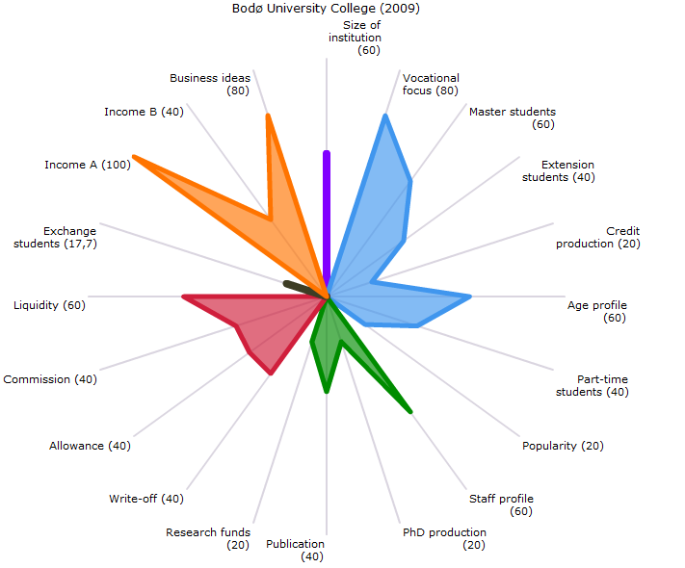

Slide 26
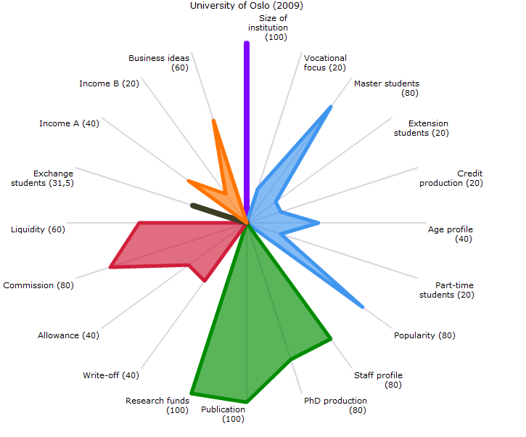

Slide 28
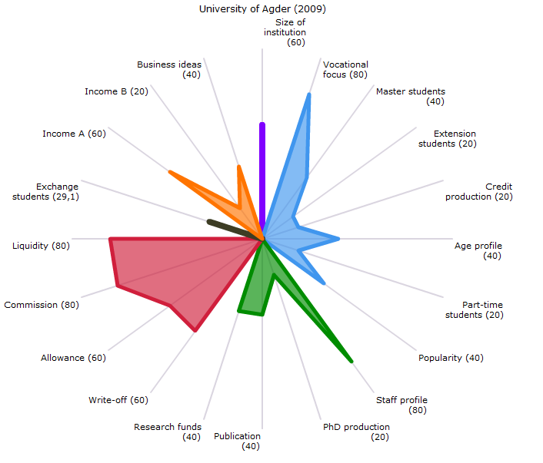

Slide 30
Notes:
The Norwegian Ministry of Education and Research will in April/May this year, publish new Institutional profiles of the Norwegian HEIs – based on 2010 figures.
Furthermore, there will actually be a kind of division of labor between the Ministry and NOKUT (Norwegian Agency for Quality Assurance in Education).
In cooperation with DBH, we will try to develop profiles on academic field level (e.g. medicine, social science), while the Ministry will concentrate on institutional level. Both are based on available register data.

