Slide 1
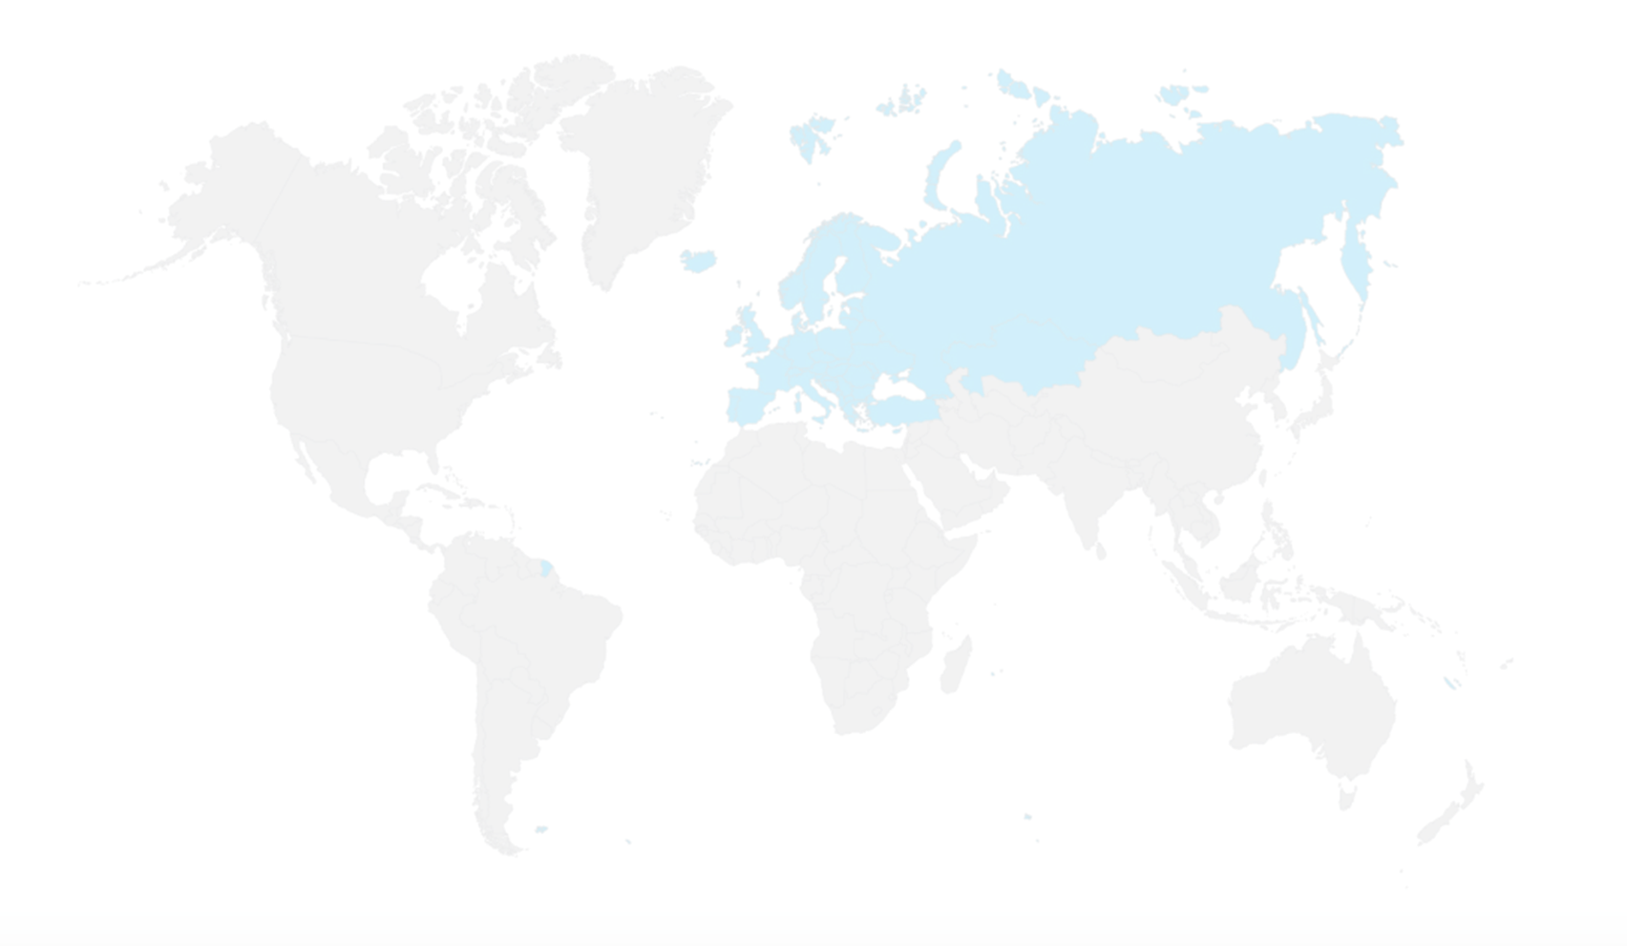


Update CG on Global Policy Dialogue
Magalie Soenen – co-chair
BFUG board meeting
5/10/2022

Slide 2
Set up of CG on Global Policy Dialogue
Chaired by 4 co-chairs: Belgium/Flemish Community, Italy, Albania and European Commission
15 members take part (Albania, Austria, Belgium/Flemish Community, Belgium/French Community, France, Germany, Holy See, Ireland, Italy, Kazakhstan, Malta, the Netherlands, Romania, Spain, UK)
6 organisations (EI-ETUCE, ENQA, ESU, EUA, European Commission, UNESCO)

Slide 3
Meetings of CG on Global Policy Dialogue
First meeting on 7th June 2021
Second meeting on 13th January 2022
Third meeting on 1st June 2022
Fourth meeting planned on 24th October 2022
In between work in the subgroups and follow-up of work plan

Slide 4
Composition and focus of the subgroups
  2 functional subgroups:
    Tirana Global Policy Forum: chair Linda Pustina (AL), in her role as Vice-Chair of the BFUG, the members are the Netherlands, UK, France
    Drafting the statement: chair Kathy Isaacs (IT), complemented with Holy See, Ireland, the Netherlands, UK and ETUCE as members
  3 regional subgroups:
    Asia: chair Magalie Soenen (BE/FL), members are France, Germany, Holy See, Romania, The Netherlands, EC, EUA, ESU, and UNESCO
    Africa: chair Fiorella Perotto (EC), members are Austria, Belgium/FR, France, Germany, Holy See, Romania, the Netherlands, ENQA, EUA and UNESCO
    Americas: chair Kathy Isaacs (IT), members are Austria, Holy See, Ireland, Malta, the Netherlands, EC and UNESCO

Slide 5
Outcomes of the subgroups
  Each subgroup had several meetings (2 to 4 meetings)
  3 ongoing mapping exercises:
    Contact list global partners
    Mapping of regional events & activities
    Mapping of topics/themes and regions (looking for synergies between ongoing processes)
  Policy brief for UNESCO World Higher Education Conference on ‘Promoting Policy Dialogue among the European Higher Education Area (EHEA) and the other world higher education regions’ was submitted, May 2022:
  https://whec2022.net/resources/Coordination%20Group%20Global%20Policy%20Dialogue.pdf

Slide 6
Outcomes of the subgroups
  Focus on Africa
  Reflections on the new AU-EU innovation agenda (a set of reflections as part of the public consultation on the AU-EU Innovation Agenda launched at the EU-Africa Business Forum in February 2022), June 2022
  Preparation of 3 EHEA conversations: online events/webinars with 3-4 experts from the EHEA and Africa, representing regional organisations. Duration: 1,5-2 hours.
  Theme: recognition
  Start by inviting regional representatives, later go to more practical implementation at institutional level.
  First webinar planned around 15 December 2022
  Content: needs further work, “Instruments, tools and practices at regional* and national level”

Slide 7
Outcomes of the subgroups
  Focus on Americas
  Idea of organizing similar online activities as Africa group
  DAAD Bologna Hub event, “Global Dialogue on Micro-Credentials: Initiatives and Perspectives on Small Learning Units from around the World”, 23 June; co-chair K. Isaacs lead of Americas section
  Proposed hybrid Colloquium between CG/EHEA and Mercosur, 5/12/2022, in Montevideo, representatives of Argentina, Brazil, Bolivia, Chile, Colombia, Ecuador, Paraguay. Perù, Uruguay and Venezuela, topic “Enhancing Global Policy Dialogue on Higher Education”
  Submitted a proposal for a session at the CHEA (US accreditation body) Annual Conference which will be held in Washington DC on 23 January, topic “Let's Talk: fostering global dialogue about diversity in a common framework”
  Draft communication text for contact with regional contacts

Slide 8
Outcomes of the subgroups so far
  Focus on Asia
  Сonference of Central Asian Ministers of Education «Central Asian Higher Educational Area: regional cooperation, national reforms», 18 June 2022; 2 co-chairs participated (K. Isaacs & L. Pustina),
    Expanding the Bologna Process in the Central Asian Countries: Forms, Methods
    Trends in the Development of Higher Education in the Bologna Process
  EU-SHARE conference on micro-credentials, 20-21 July 2022, Bangkok; 1 co-chair and 2 group members joined (M. Soenen, EUA and Germany)
    Micro-Credentials – the European Perspective
  ASEM process is starting up again: ISOM meeting 24-25 November 2022, Malta -> looking for synergies, to be further discussed among group members
  PLA on inclusive mobility planned EHEA-ASEM by BE/FL in spring 2023
  Discuss with subgroup on similar webinars as other two groups

Slide 9
Roadmap of the CG
  Subgroups continue work on different activities
  Co-chairs encourage synergies between the work of the groups
  Co-chairs investigate synergy with INGLOBAL project
  Exploring possible changes to the project to allow for more flexibility. No clear information on proposed steps from the project team on activities (questionnaires, hiring expert, mapping mobility flows, etc.)
  24 Oct: 4th CG meeting
  From 2023: start up of the subgroups on the GPF and GPF statement

